Slide 1
Live Session 12
Logistic Regression

Slide 2
Project 2 We will finalize due dates soon.
Next Week (Wk 13)
Clustering
Heatmaps
R scripts (Some is available this week)
Incorporating clustering algorithms in classification analysis
Week 14
Project 2 discussions
Discussion of nonparametric predictive models (Decision Trees and Random Forests)
This will be high level discussion on what makes them different and why they are favored in some applications over the techniques discussed in this course.

Slide 3
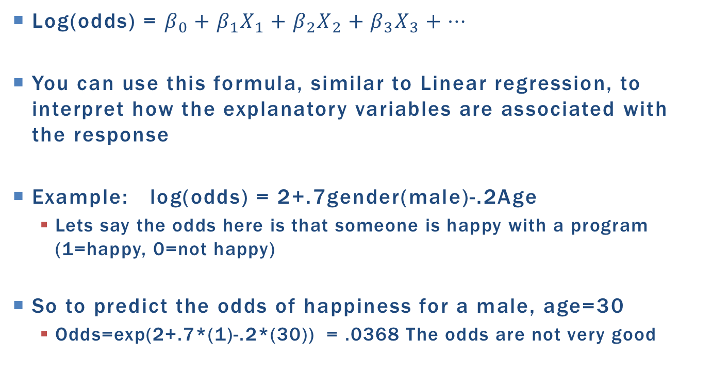
Key Formula for logistic regression
Log(odds) = $β_{0}+β_{1}X_{1}+β_{2}X_{2}+β_{3}X_{3}+…$
You can use this formula, similar to Linear regression, to interpret how the explanatory variables are associated with the response
Example: log(odds) = 2+.7gender(male)-.2Age
Lets say the odds here is that someone is happy with a program (1=happy, 0=not happy)
So to predict the odds of happiness for a male, age=30
Odds=exp(2+.7*(1)-.2*(30)) = .0368 The odds are not very good

Slide 4
Calculating odds ratios
Example: log(odds) = 2+.7gender(male)-.2Age
What is the odds ratio between male vs female for age 30?
Formulaic way
Odds for males, age 30 = .0368
Odds for females, age 30 = exp(2+.7*(0)+.2*30) = .0183
Odds ratio (m/f) = .0368/.0183 = 2.01
If you do the algebra, you will see that 2.01 is actually just
Exp(.7) the coeffecient for males in the model!
So you get the same answer no matter what age you had picked

Slide 5
Calculating Odds Ratio
Example: log(odds) = 2+.7gender(male)-.2Age
Suppose age is in months.
Exp(.2)=1.22. For every 1 unit increase in Age, the odds will increase by a multiplicative factor of 1.22 holding gender fixed. The odds ratio (40year olds compared to 41 year olds) is 1.22
Some times explaining one unit increases is silly. Suppose Age was in months but it makes more sense to talk about it in years.
The odds ratio for the difference between two ages holding everything else fixed is simply exp[ (age1-age2)*coefficient.
So a year difference is 12 months (doesn’t matter if it is 12-0 or 36-24)
Exp(12*.2)=11.02318 so for every one year increase the odds of happiness will increase by a multiplicative factor of 11.02318 holding the other explanatories fixed

Slide 6
Quick note about interactions
When you have multiple explanatory variables that include interactions or have a quadratic term, it takes a little more care in calculating an appropriate odds ratio.
Recall, if interactions were significant we never reported an overall mean of the main factors, we had to go in and provide comparisons of the means by the different factor levels.
See ODDSRATIO option in PROC logistic. It allows you to calculate odds ratios for one explanatory variable given the other variable is specified.
Honestly: Interactions are somewhat avoided like the plague due to their added difficulty in interpretation. We can utilize prediction plots to help people understand what is going on.

Slide 7
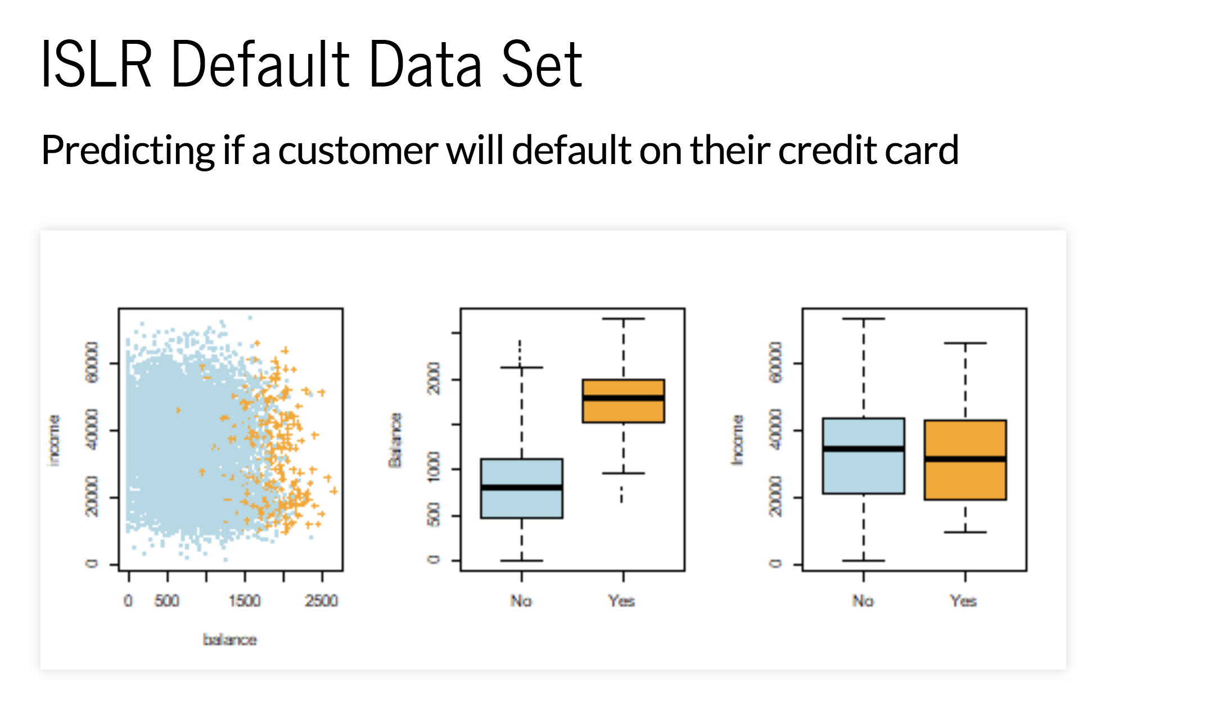
Why Is Log(ODDS) being thrown around everywhere?

Slide 8
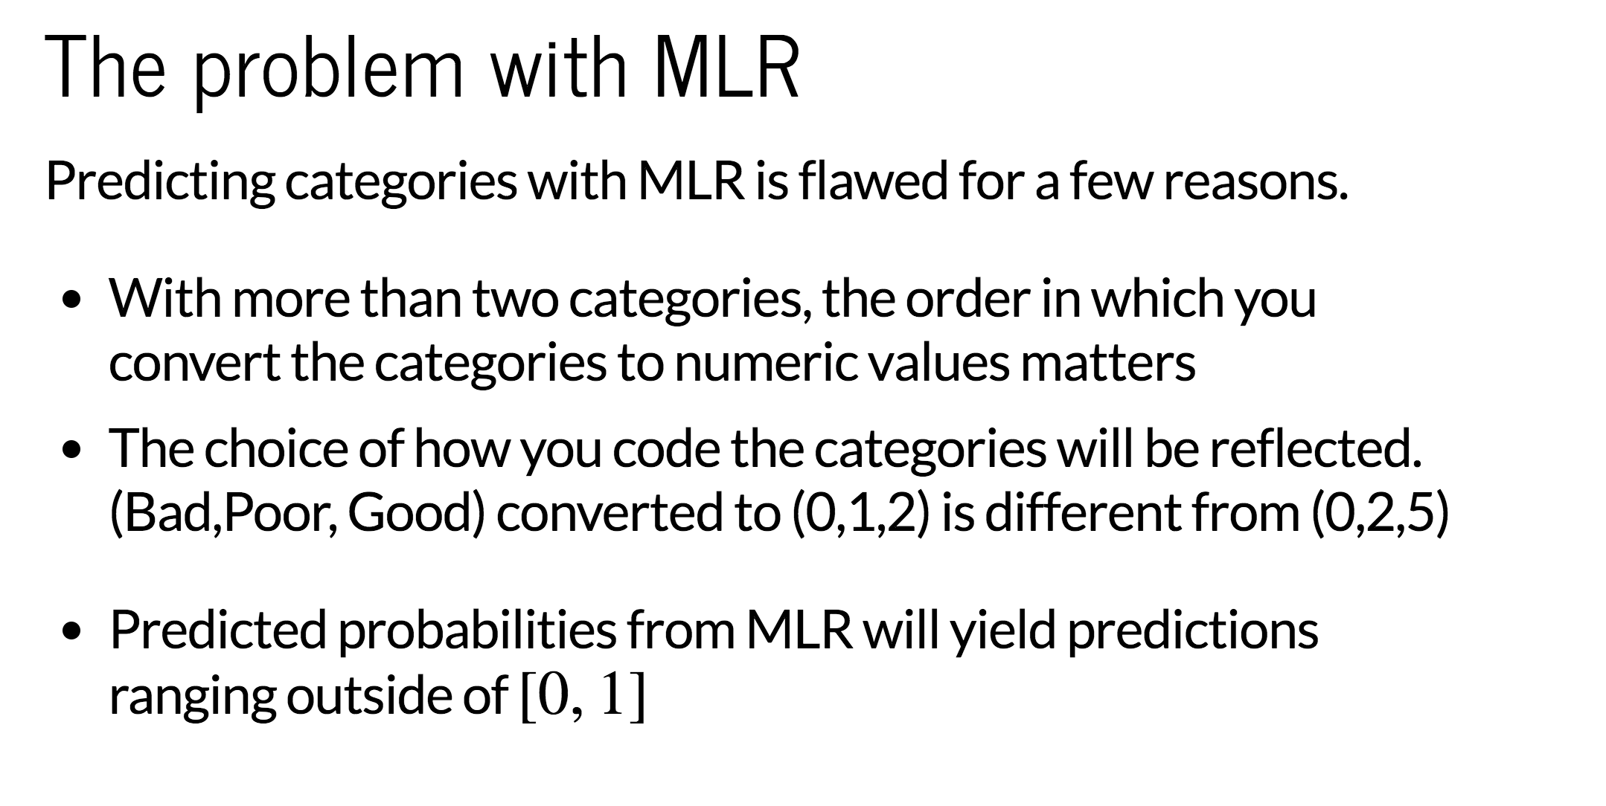

Slide 9
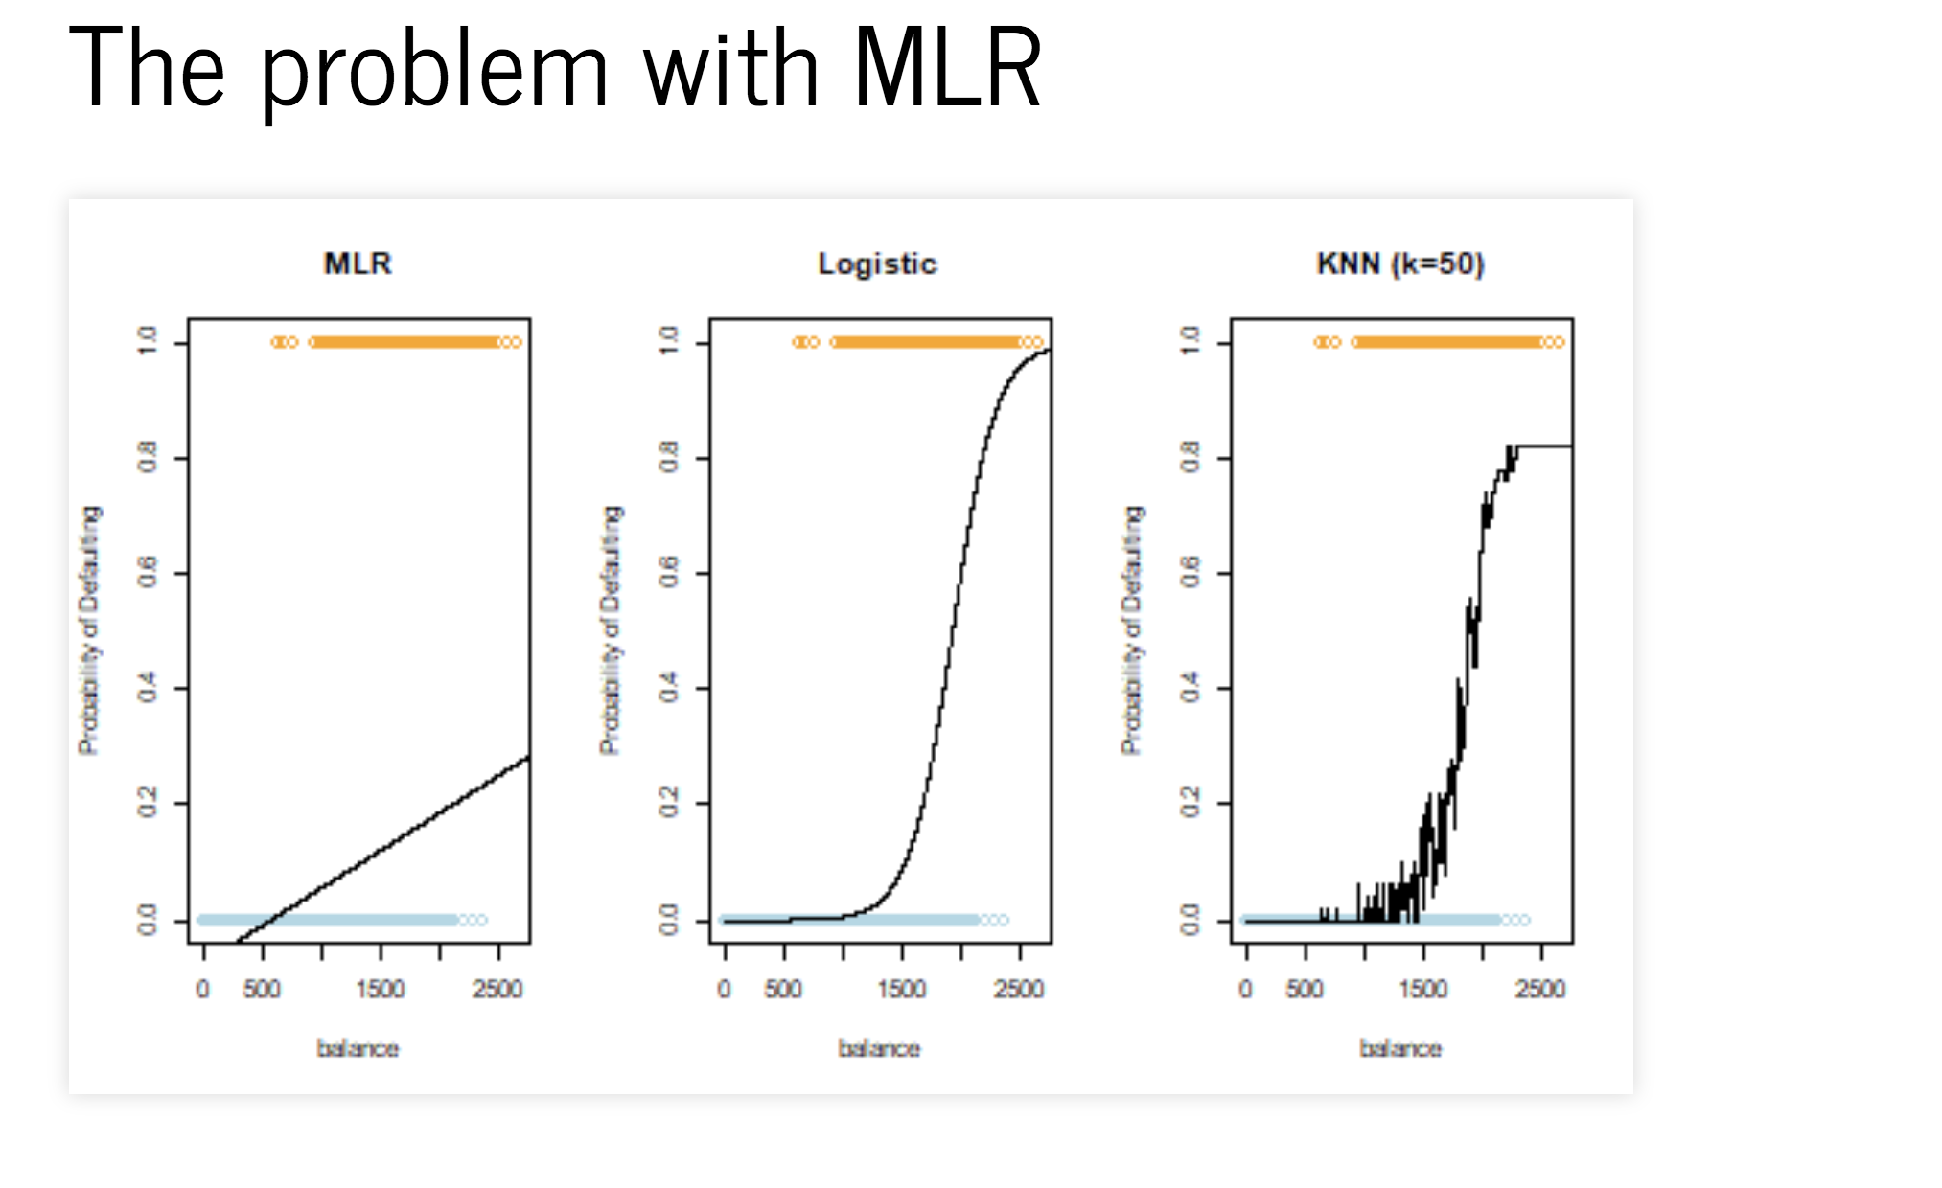

Slide 10
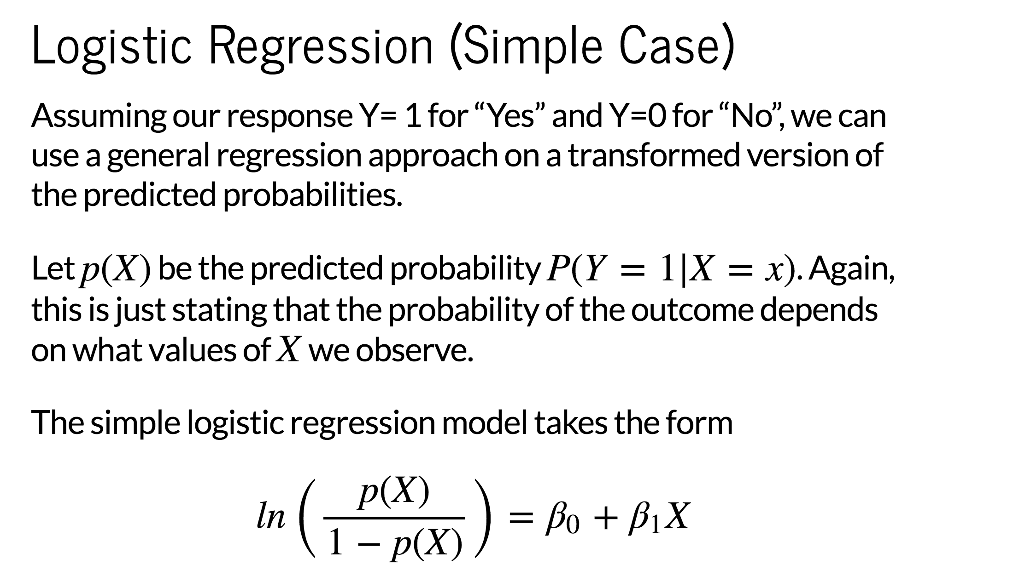

Slide 11
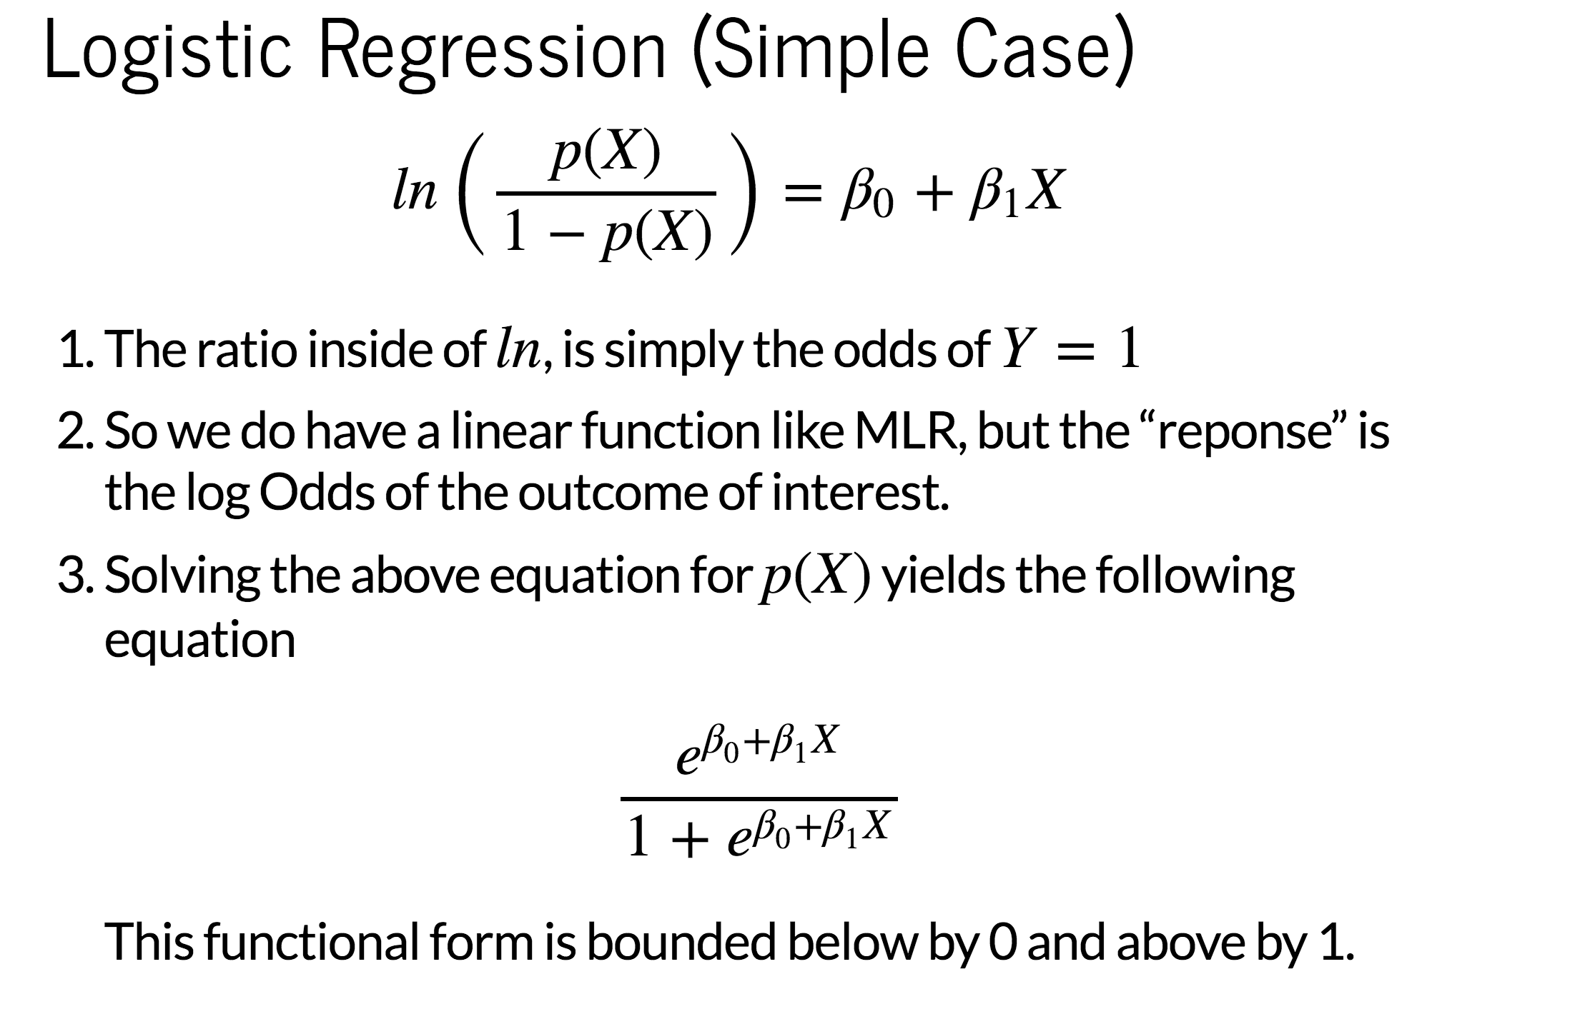

Slide 12
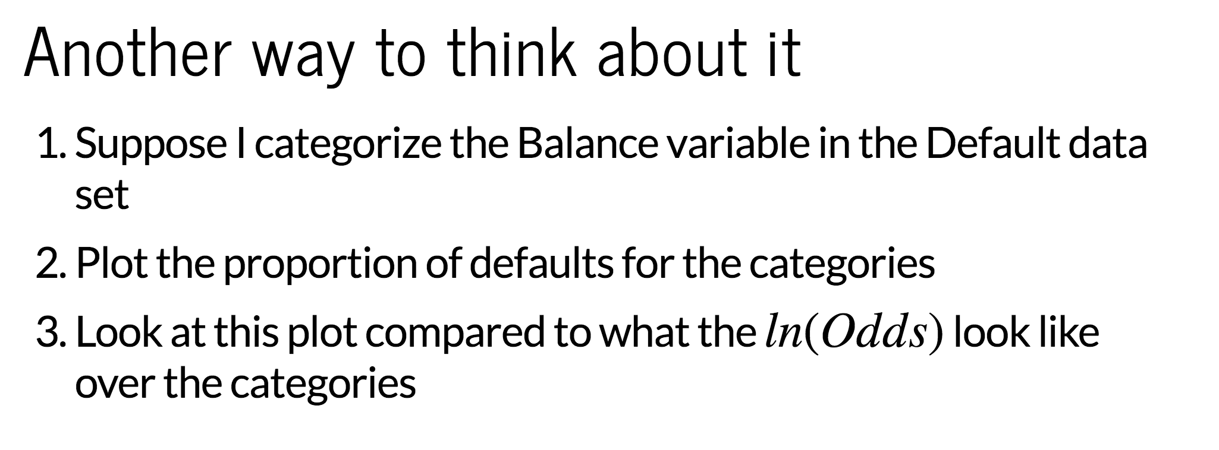

Slide 13
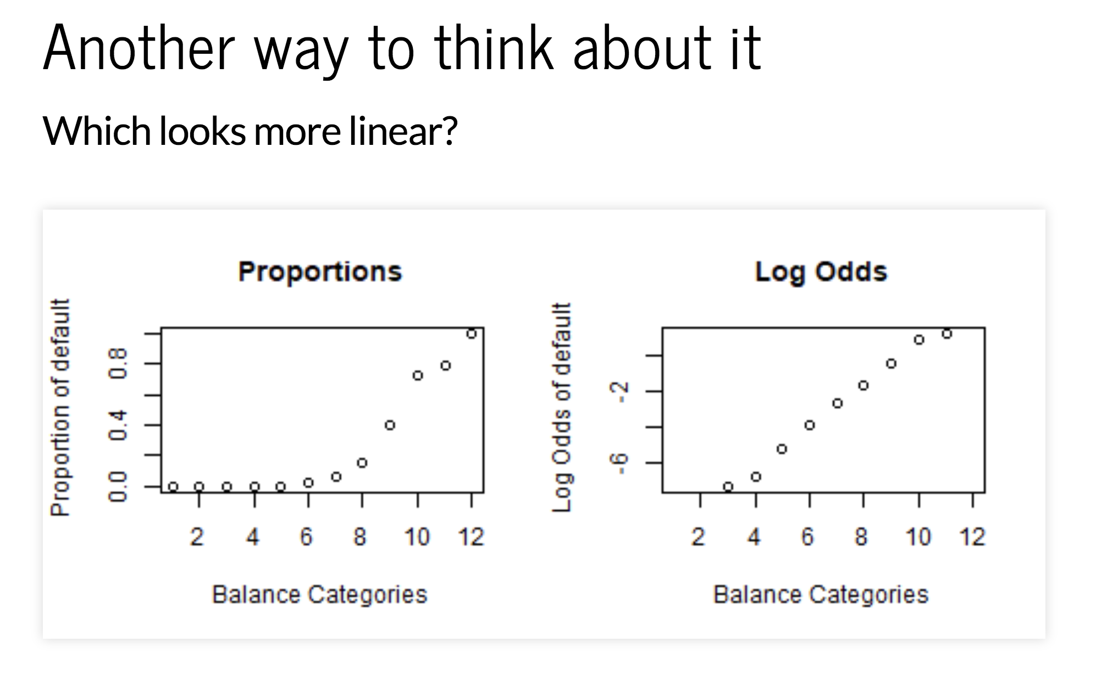

Slide 14
General Analysis Overview
Logistic regression is multiple regression for a dichotomous outcome
Typically two purposes.
Understanding how certain explanatory variables may influence the likelihood of an event occurring
Can certain explanatory variables be used to predict if an event will occur or not

Slide 15
General analysis Overview
EDA
Summary tables of the response versus categories through contingency tables (PROC FREQ). Multicollinearity is also a concern here.
Summarize continuous variables by response status (PROC MEANS)
If multiple continuous variables exist, pairwise scatter plots but color coded or labeled by response status are helpful
Get a feel of what variables might have an impact on the likelihood of the response occurring. It also gives an idea of the sample size breakdown.

Slide 16
General analysis Overview
Model Fitting
Same approaches as in MLR
Feature selection
Common sense/manual iteration
Consider adding complexity through interactions, transformations, etc.
You can also fit individual logistic regressions one explanatory variable at a time as a data screening process to reduce the number of variables down.
It may make sense to include interactions up front if that is a key question of interest

Slide 17
General Analysis overview
Assess Goodness of Fit / Tests of Lack of Fit / Assessing if we have a good model
There are multiple ways to do this depending on what your explanatory variables are
If you have only categorical predictors
Deviance and Pearson Goodness of Fit tests
Comparing model to a more complex one (Forward selection)
LASSO
Hosmer-Lemeshow test
If you have at least one or more continuous predictors
Comparing model to a more complex one (Forward selection)
LASSO
Hosmer-Lemeshow test
NOTE: Goodness of Fit and Hosmer-Lemeshow tests are from the days of moderate to small sample sizes. An alternative way to make sure your model fits well is through prediction accuracies of test sets or cross validation.
Regardless of predictors: Residual diagnostics
Key focus is identifying potential leverage points and investigation
Residuals WILL have patterns that you’re not accustomed to seeing compared to regular regression (Further discussion)

Slide 18
General Analysis overview
Once finished with the iteratively fitting models and you are comfortable.
Provide estimates of the coefficients in the most interpretable way (live session discussion) highlighting the statistically significant ones and their interpretation if understanding the explanatories is important.
Provide prediction performance through ROC curves and confusion matrices if prediction is important.

Slide 19
Coronary artery disease
Some people have CA disease some people don’t
Question 1: Can we assess what sort of risk factors play a role in this disease? Do combination of factors play a bigger role than just the single factors?
(This is like saying, which explanatory variables are significant in the logistic regression model and change the odds of having the disease.)
Question 2: Can we use a statistical model to effectively predict if a person has the disease or not?

Slide 20
SAS data set
data coronary;
input sex ecg age ca @@ ;
cards;
0 0 28 0 1 0 42 1 0 1 46 0 1 1 45 0
0 0 34 0 1 0 44 1 0 1 48 1 1 1 45 1
0 0 38 0 1 0 45 0 0 1 49 0 1 1 45 1
Sex (female=0 male=1)
ECG(0 , 1, or 2) ST segment depression Low Medium High
Age (in years)
Key Question: What are the risk factors for coronary artery disease?

Slide 21
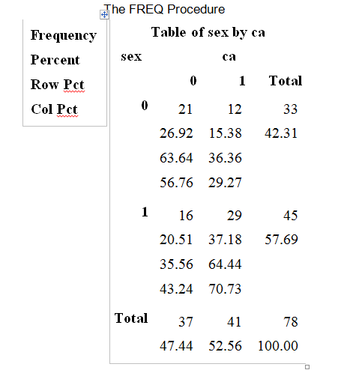
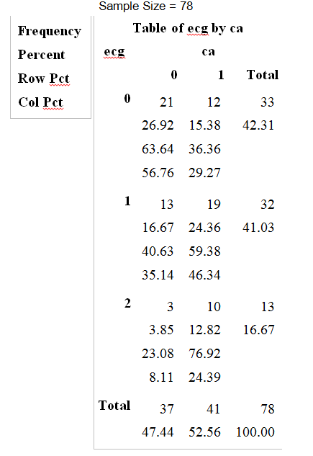
Understand and explore
Sampling scheme multinomial. Subjects records were obtained at a local hospital. Randomly sampled 78 subjects and then observed if they had CA disease and all the other potential risk factors.

Slide 22
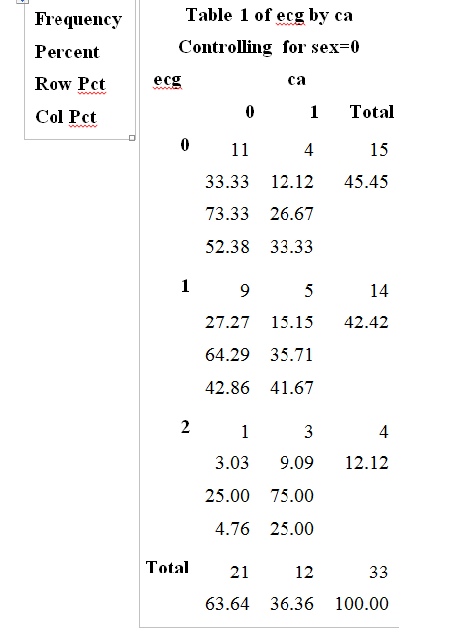
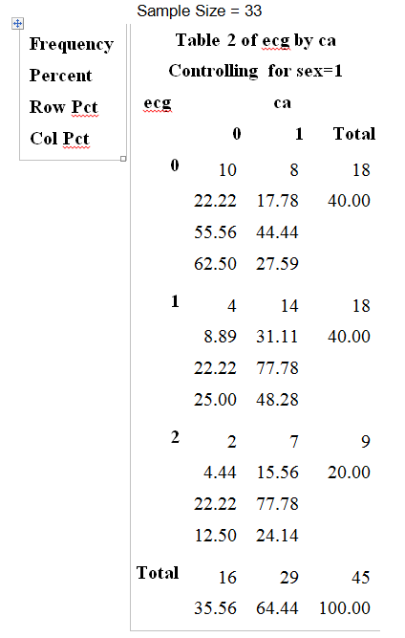
Understand and Explore
MALE
FEMALE

Slide 23
Understand and Explore
Analysis Variable : age
ca | N Obs | N | Mean | Std Dev | Minimum | Maximum
0 | 37 | 37 | 44.0810811 | 7.8999943 | 28.00 | 59.00
1 | 41 | 41 | 49.4390244 | 8.4055005 | 32.00 | 63.00
Analysis Variable : age
ca | sex | N Obs | N | Mean | Std Dev | Minimum | Maximum
0 | 0 | 21 | 21 | 45.0952381 | 8.1172949 | 28.0000000 | 59.0000000
 | 1 | 16 | 16 | 42.7500000 | 7.6550637 | 30.0000000 | 55.0000000
1 | 0 | 12 | 12 | 50.6666667 | 8.4888519 | 32.0000000 | 60.0000000
 | 1 | 29 | 29 | 48.9310345 | 8.4681379 | 36.0000000 | 63.0000000

Slide 24
Quick overview so far
Looks like all variables could contribute
Interaction may exist between ECG and Sex
Interaction with age is hard to tell

Slide 25
Fit a main effects model
proc logistic data=coronary ;
class sex ecg / param=ref;
model ca(event='1')= sex ecg age/ scale=none aggregate lackfit inluence;
effectplot;
effectplot slicefit(sliceby=Sex plotby=ecg) / noobs;
run;

Slide 26
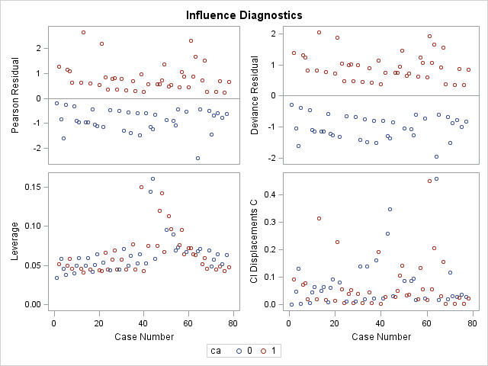
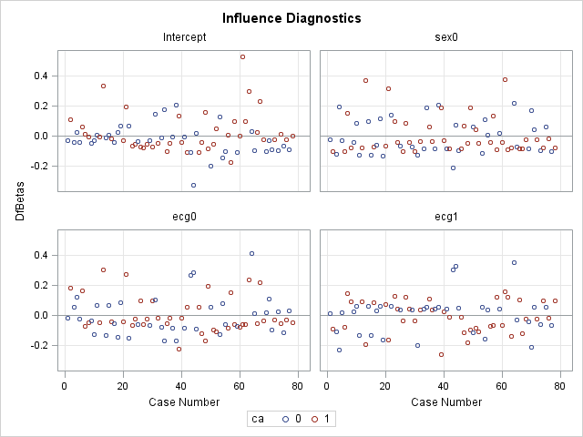
Assess the fit
Hosmer and Lemeshow Goodness-of-Fit Test
Chi-Square | DF | Pr > ChiSq
5.6551 | 7 | 0.5806

Slide 27
See if additional components can fit better
proc logistic data=coronary ;
class sex ecg / param=ref;
model ca(event='1')= sex ecg age sex*ecg sex*age ecg*age age*age/ selection=FORWARD start=3 scale=none details influence lackfit;
effectplot;
effectplot slicefit(sliceby=Sex plotby=ecg) / noobs;
run;

Slide 28
Results from Forward selection
Note: | No (additional) effects met the 0.05 significance level for entry into the model.
Analysis of Effects Eligible for Entry
Effect | DF | Score Chi-Square | Pr > ChiSq
sex*ecg | 2 | 1.0799 | 0.5828
age*sex | 1 | 0.0148 | 0.9032
age*ecg | 2 | 0.8746 | 0.6458
age*age | 1 | 0.8264 | 0.3633
With no additions, we can move on to final statistical analysis reporting.
Note: If more parameters are added go back through residual diagnostics.

Slide 29
Report Overall Test
Testing Global Null Hypothesis: BETA=0
Test | Chi-Square | DF | Pr > ChiSq
Likelihood Ratio | 21.4878 | 4 | 0.0003
Score | 18.9094 | 4 | 0.0008
Wald | 14.6894 | 4 | 0.0054
Type 3 Analysis of Effects
Effect | DF | Wald Chi-Square | Pr > ChiSq
sex | 1 | 6.3416 | 0.0118
ecg | 2 | 5.6706 | 0.0587
age | 1 | 7.2340 | 0.0072

Slide 30
Analysis of Maximum Likelihood Estimates
Parameter |  | DF | Estimate | Standard Error | Wald Chi-Square | Pr > ChiSq
Intercept |  | 1 | -2.9278 | 1.7752 | 2.7201 | 0.0991
sex | 0 | 1 | -1.3897 | 0.5518 | 6.3416 | 0.0118
ecg | 0 | 1 | -1.5593 | 0.8026 | 3.7743 | 0.0520
ecg | 1 | 1 | -0.4278 | 0.8078 | 0.2805 | 0.5964
age |  | 1 | 0.0956 | 0.0356 | 7.2340 | 0.0072
Odds Ratio Estimates
Effect | Point Estimate | 95% Wald Confidence Limits
sex 0 vs 1 | 0.249 | 0.084 | 0.735
ecg 0 vs 2 | 0.210 | 0.044 | 1.014
ecg 1 vs 2 | 0.652 | 0.134 | 3.176
age | 1.100 | 1.026 | 1.180

Slide 31
Provide meaningful interpretation
The odds ratio of CA disease for females relative to males is 0.249 after accounting for AGE and EGC (95% CI (.084,.735)). The odds for a female to have CA disease is 75.1% less than the odds for male. (Recall could have fliped 1/.249~4!!)
The odds of a person having CA disease is 1.1 times higher than a person 1 year younger holding all other variables fixed. The odds of a person having CA disease is 2.6 times higher than a person 10 years younger (AOVF).
Odds Ratio Estimates
Effect | Point Estimate | 95% Wald Confidence Limits
sex 0 vs 1 | 0.249 | 0.084 | 0.735
ecg 0 vs 2 | 0.210 | 0.044 | 1.014
ecg 1 vs 2 | 0.652 | 0.134 | 3.176
age | 1.100 | 1.026 | 1.180

Slide 32
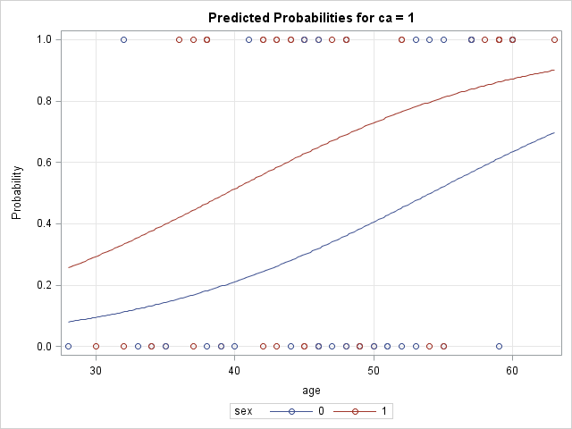
Effects plot can be helpful to explain
Predicted probabilities given age and sex value
NOTE: This is exp(b0+b1X1+….) / 1+exp(b0+b1X1+….)

Slide 33
What if we want to predict
The most intuitive way to check the adequacy of the model predictions is through ROC curves (Receiver operating characteristics curve)
Cool history story if we have time.

Slide 34
One way is just to create a table (Hypothetical numbers)
Truth
 | CA Disease | Not CA
Predict CA | 20 | 7
Predicted Not | 6 | 10
Classification
However, its possible to conjure up data sets that yield very similar tables, but one is able to more confidently provide the prediction than the other. How is that?

Slide 35
SAS ctable option
Classification Table
Prob Level | Correct |  | Incorrect |  | Percentages
 | Event | Non- Event | Event | Non- Event | Correct | Sensi- tivity | Speci- ficity | False POS | False NEG
0.500 | 30 | 22 | 15 | 11 | 66.7 | 73.2 | 59.5 | 33.3 | 33.3
 | CA Disease | Not CA
Predict CA | 30 | 15
Predicted Not | 11 | 22

Slide 36
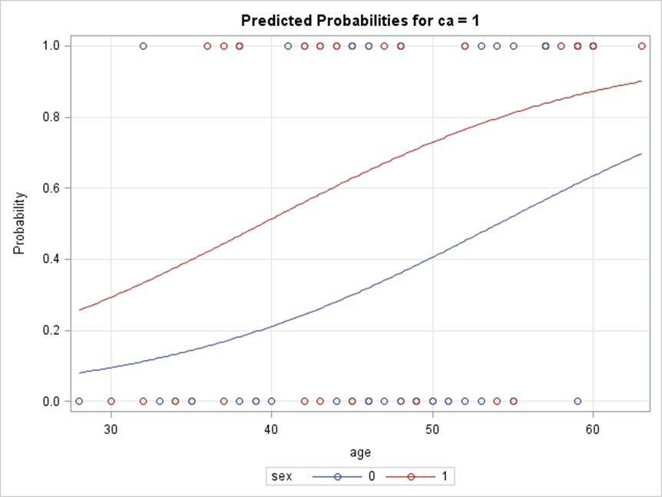
Effects Plot
When the predicted probably curve is steeper and plateus to 0 and 1 more quickly, predicted probabilities are more closer to 0 or 1.

Slide 37
When the predicted probably curve is steeper and plateaus to 0 and 1 more quickly, predicted probabilities are more closer to 0 or 1.

Slide 38
What if we want to predict
Predicting a new subject is easy
Calculate the predicted probability (aka HW Problem #4 last graph)
If its bigger than .5 its predicted that the event will occur
The .5 is somewhat arbitrary we could technically pick any cut point between 0 and 1
ROC curves combine
Sensitivity (Ability to correctly predict when an event occurs)
1-Specificity (FALSE POSITIVES)
If a model is doing very well, then most of the predicted probabilities will be close to 0 or 1, so changing the cut point doesn’t matter too much.
However, if it doesn’t predict as well, changing the cut point can alter the predictions quite a bit. Example: cutpoint changed to .25, we are able to predict more events correctly but at the expense of more false predictions of the event.
Simple graphic and number can summarize this quite nicely

Slide 39
ROC CURVE
proc logistic data=coronary ;
class sex ecg / param=ref;
model ca(event='1')= sex ecg age / scale=none aggregate lackfit;
ROC 'MainEffects' sex ecg age;
ROC 'Just Sex/AGE' sex age ;
roccontrast reference('Just Sex/AGE') / estimate e;
run;

Slide 40
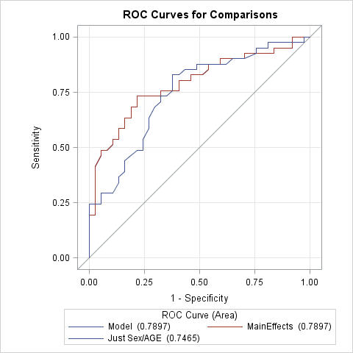
ROC CURVE for Our Example (This graph may be different than the one SAS will produce from my SAS code)

Slide 41
ROC curves
Widely used to assess performances of different models to predict categorical groups.
I do not believe LDA has this option in SAS
Area under the curve closer to 1 indicates better accuracy in the model’s ability to predict.
ROC curves close to the 45 degree line indicating that you could do just as a good job by randomly guessing.

Slide 42
General EDA techniques still apply
You can use PCA to reduce number of continuous predictors
Multicolinearity still happens so removing redundancies and screening noninformative variables is good practice.

Slide 43
Other SAS info
UNITS option allows you calculate odds ratio for situations like HW #3
If Age is in your model and you want the ODDS ratio depicted as an increment of 10 rather than 1 you semply specify
UNITS age=10;
SCORE option allows you to define a separate data set (test/validation set) to assess how well your model can predict new data
ODDSRATIO is the go to option if you want to report an odds ratio when the variable of interest has a significant interaction with another variable.
CTABLE Obtain classification results
ROCOPTIONS(CROSSVALIDATE) in the proc logistic statement SAS 9.4
For SAS 9.3
proc logistic data=alldata; model y(event="1") = explanaotry; output out=preds predprobs=crossvalidate; run;
proc logistic data=preds; model y(event="1") = explanatory; roc pred=xp_1; roccontrast; run;

Slide 44
More than 2 response categories
Proc logistic handles them just fine. The interpretation of the odds ratio changes just slightly depending on how the model is structured.
For example. Suppose instead of a response “Strongly Agree/Everything Else” we wanted Agree,Middle,Disagree
PROC logistic has to set one of the categories as the reference categories for the ODDS Ratio to be calculated based on
So if the reference is Diasagree.
ODDs ratio tables are Agree/Disagree and Middle/Disagree
When categories have a distinct order (ordinal): There are additional approaches)
ROC curves are probably not available for this case as they are more complex

